Slide 1
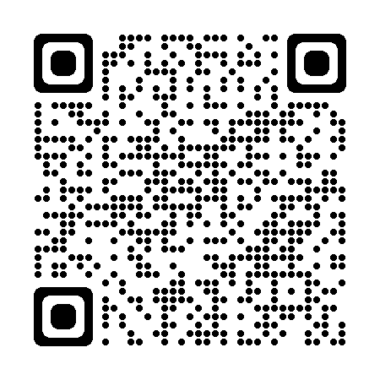





















David Chu thedavidchu@berkeley.edu
davidchuyaya/disk-tees (github.com)
Rollbaccine: the rollback vaccine
Confidential Computing
Advised by Heidi Howard
Trusted execution can’t prevent rollback attacks
Existing solutions are either slow or not general
Our solution:
If you can’t trust disk, trust memory 🧠
All applications interact with the disk through the file system 📂
The file system has APIs that explicitly guarantee persistence: fsync 🔄
🫖
🐌
ROTE
👿
USENIX Security ‘17
Increment a counter 🧮 on each write
Store it on disk 💿 and sign ✍️
Sync counter with quorum of TEEs 🫖
Verify on read
CFT
TEE
BFT
Engraft
Original:
Rollbaccine:
🤏
✔ CPU
✔ Memory
✔ Disk
✔ CPU
✔ Memory
✖ Disk
✖ CPU
✖ Memory
✖ Disk
📟
📟
CCS ‘22
Change metadata 📊 on each write
Store data on disk 💿
Sync metadata with quorum of TEEs 🫖
Verify on read
📟
Postgres🛢️
💿
Postgres🛢️
🧠
Write hello.txt
Read hello.txt
Nimble
Writes ✍️ are async
Reads 📖 remain local
🧠
🧠
🧠
OSDI ‘23
Store tail of ledger🧾 with quorum of TEEs 🫖
Verify on read
💿
🫖
🫖
🫖
Read ???.txt or
Read oldHello.txt
Network 📶 latency << Disk 💿 write latency

